Slide 1
CS174A Lecture 16

Slide 2
Announcements & Reminders
3/06/24: A4 due; will be discussed during this week’s TA session
3/07/24: Prof Demetri’s presentation (Zoom, no recording)
3/07/24 - 3/16/24: Course evaluations (0% at this point)
Team Project Timelines: see project info document on Canvas
Team project grade increased from 150 to 175 (download latest team project info)
3/19/24: Final exam, 6:30-8:15 PM, in person, location BH 3400
Final exam grade reduced from 150 to 125 (download latest syllabus)
Study guide and book exercises posted
3/18 & 3/19: Office hours, Noon-1PM

Slide 3
Last Lecture Recap
Ray Tracing
Issues: speed, shadows, aliasing
Stochastic ray tracing

Slide 4
Next Up
Prof Demetri presentation
Midway demo post-mortem
Transparent Objects, Compositing
Particle Rendering
Volume Rendering
Aliasing/Anti-Aliasing
Incremental Calculations

Slide 5
Prof Demetri Presentation
Collision avoidance
Social behaviors/rules, cognitive modeling
Finite element analysis for skin/flesh
Ray tracing for eyes
Follow-up courses:
CS174C (next offered ???)
CS274C (next offered ???)
CS275 (next offered in S24 quarter)
Talk with him if you’d like to research in his area of interest

Slide 6
CS174C/274C: Computer Animation
Introduction to computer animation, including basic principles of character modeling, forward and inverse kinematics, forward and inverse dynamics, motion capture animation techniques, physics-based animation of particles and systems, and motor control.

Slide 7
CS275: Artificial Life for CG & Vision
Investigation of important role that concepts from artificial life, emerging discipline that spans computational and biological sciences, can play in construction of advanced computer graphics and vision models for virtual reality, animation, interactive games, active vision, visual sensor networks, medical image analysis, etc. Focus on comprehensive models that can realistically emulate variety of living things (plants and animals) from lower animals to humans. Exposure to effective computational modeling of natural phenomena of life and their incorporation into sophisticated, self-animating graphical entities. Specific topics include modeling plants using L-systems, biomechanical simulation and control, behavioral animation, reinforcement and neural-network learning of locomotion, cognitive modeling, artificial animals and humans, human facial animation, and artificial evolution.

Slide 8
Transparency/Opacity
Matte or Alpha: coverage info
Add a 4th channel to color: α = opacity (RGBA), range [0..1]
α = 0 ⇒ fully transparent; α = 1 ⇒ fully opaque
Transparency = 1 – Opacity
Applications
Image compositing, e.g., combining computer-rendered images with live footage
Particle rendering, e.g., smoke, snow, fire
Volume rendering

Slide 9
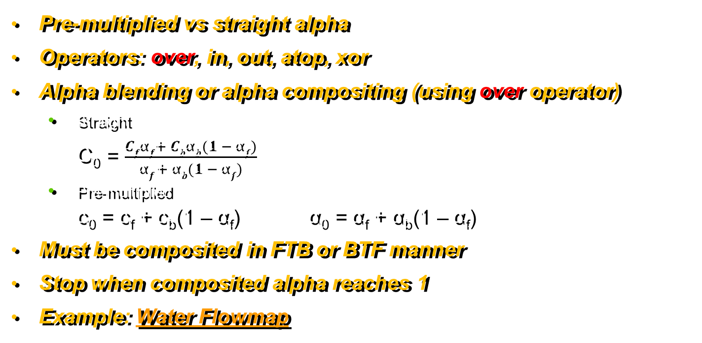
Transparency/Opacity: Compositing
Pre-multiplied vs straight alpha
Operators: over, in, out, atop, xor
Alpha blending or alpha compositing (using over operator)
Straight C₀ = $\frac{Cfαf+ Cbαb(1 − αf)}{αf + αb(1 − αf)}$
Pre-multiplied c₀ = c_{f} + c_{b}(1 – α_{f}) α₀ = α_{f} + α_{b}(1 – α_{f})
Must be composited in FTB or BTF manner
Stop when composited alpha reaches 1
Example: Water Flowmap

Slide 10
Procedural Models
For modeling cloud, smoke, water, crowd, flock, swarm, waves: using behavior
Describe objects in an algorithmic manner (e.g., spheres and ellipsoids), generate polys only when necessary
Combine computer graphics with physical laws or for modeling solid objects
Particle systems obeying Newton’s Laws, e.g., fireworks, smoke, flame
Language based models for natural objects, e.g., plants, snowflakes
Fractal geometry for natural phenomenon, using level of detail, e.g., mountains
Procedural noise for realistic motion, e.g., clouds, fluid motion

Slide 11
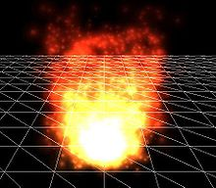
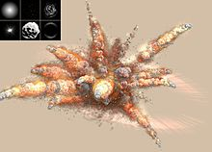
Particle Modeling
Used for simulating fuzzy phenomena
Examples: chaotic, natural or chemical systems
Like fire, smoke, explosions, snow, dust, etc.
Modeled as an emitter, like sphere or box
Particle behavior params
Spawning rate
Initial velocity vector
Lifetime
Color, etc.
Collision?

Slide 12
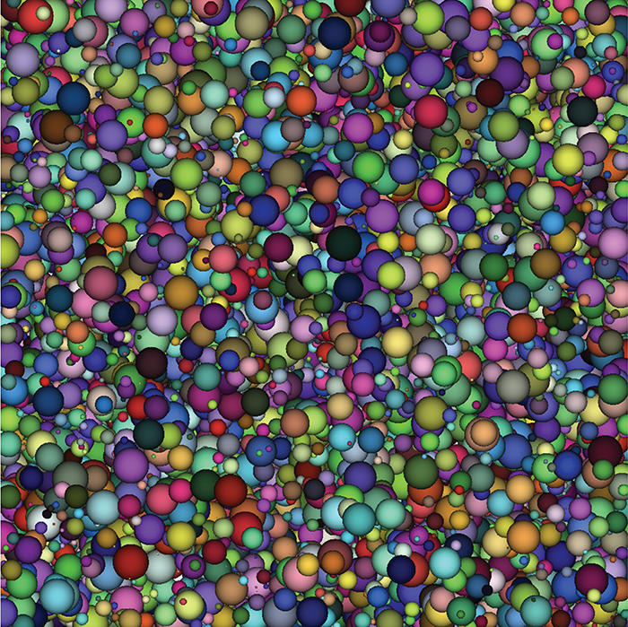
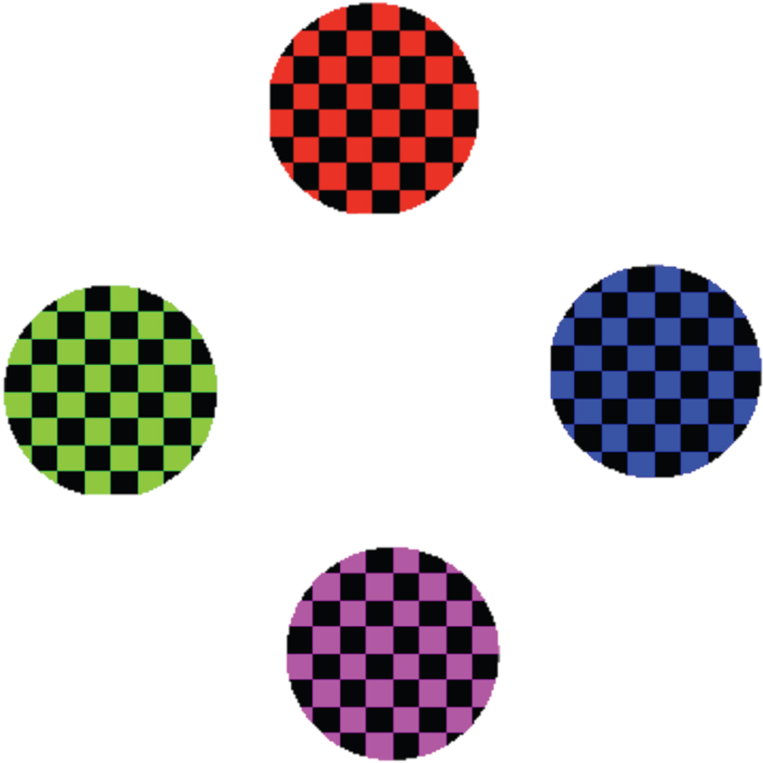
Particle Rendering
Rendered usually as textured bill-boarded quads
Sprites vs billboards
Integrate with z-buffer
In games, as a single pixel
Examples:
Particles & Billboards
Interactive 3D Graphics

Slide 13
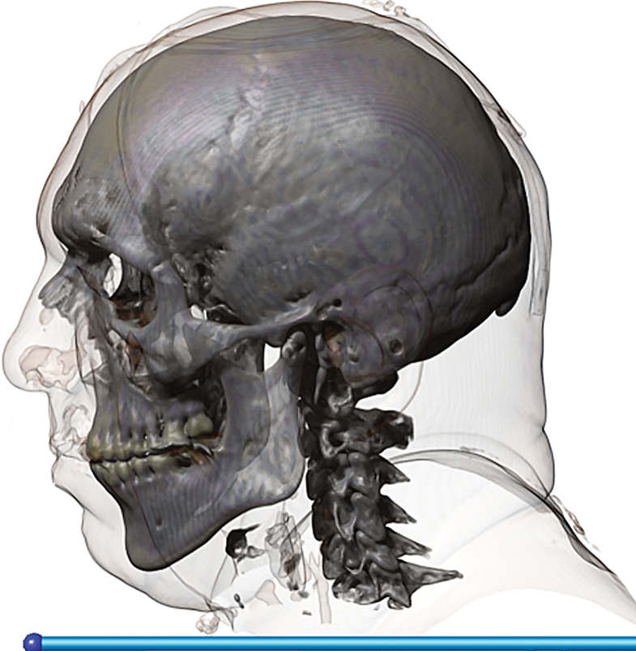
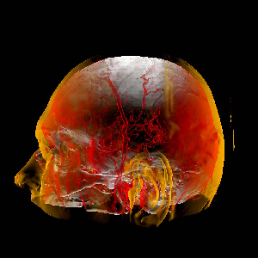
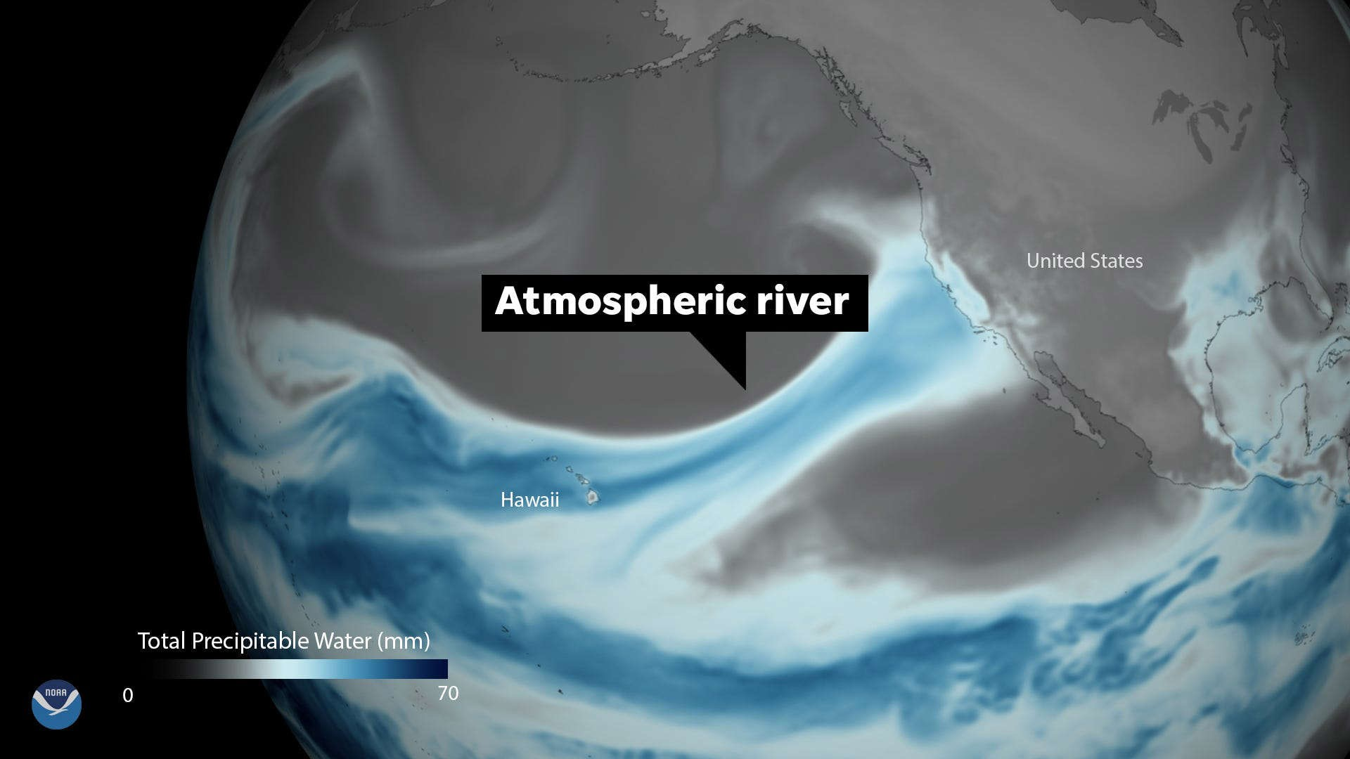
Volume Rendering
2D projection of 3D sampled dataset
Volume rendering algorithms:
Usually no illumination or shadows, just compositing
Therefore only ray-casting, no recursive ray-tracing
No perspective, only parallel projection

Slide 14
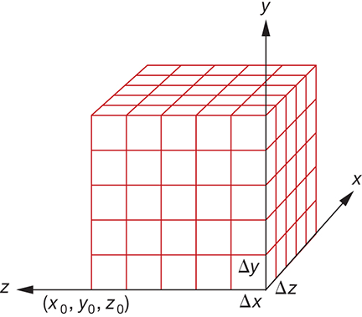
Volume Rendering: Voxels
Volume dataset: 3D regular grid of voxels
Voxel: a small cube at i,j,k with sides Δx,Δy,Δz
Each grid point has a scalar value f(x,y,z)
For example, density, intensity, CT scan, MRI
Voxelize more complex implicit solids
If Δx = Δy = Δz ⇒ structured volume dataset
Transfer function: to map lattice scalar values to RGBA
Based on viewer location, there’s a natural ordering of voxels

Slide 15
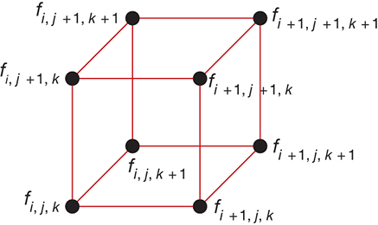
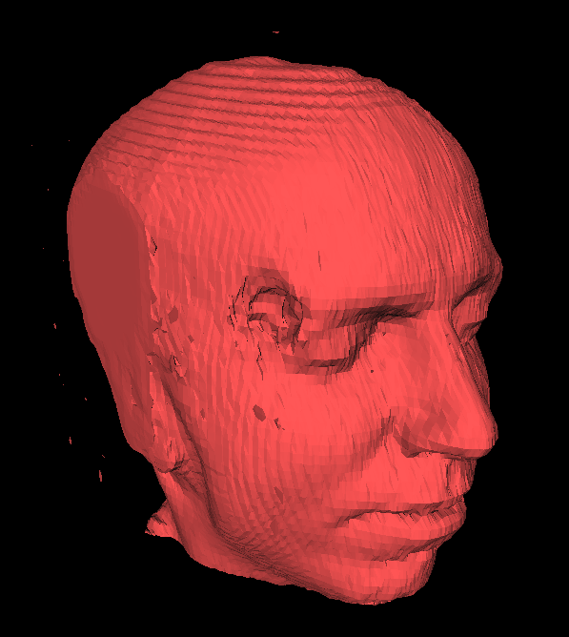
Volume Rendering: Marching Cubes
Object based volume rendering technique
Create poly mesh by extracting iso-surfaces: f_{i,j,k} = c
Color vertices: if f_{i,j,k} < c, then white, else black

Slide 16
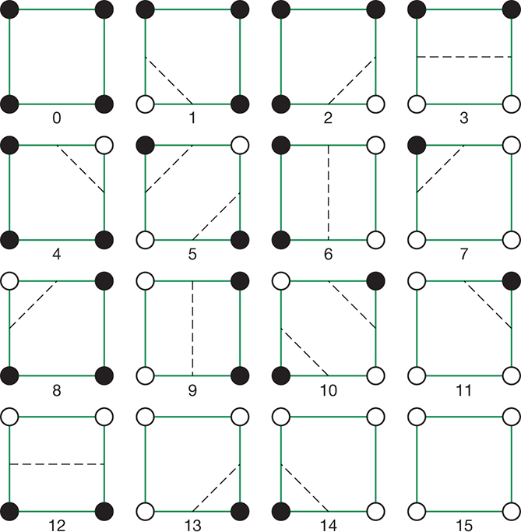
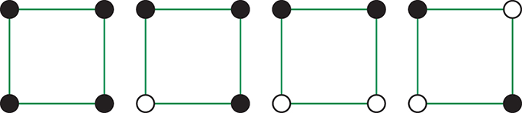
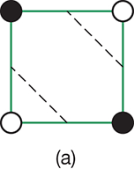
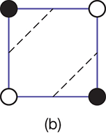
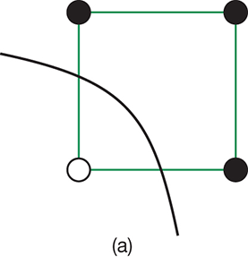
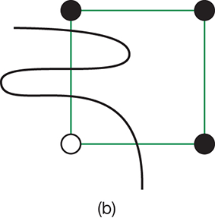
Marching Squares
16 cases of vertex labeling, but only 4 unique cases
Ambiguous cases

Slide 17
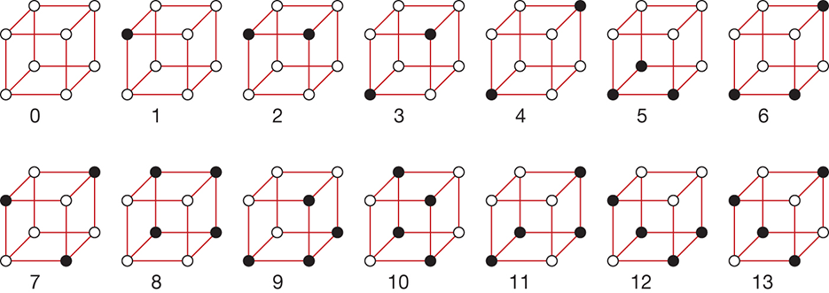
Volume Rendering: Marching Cubes
Total 2⁸ = 256, but only 14 unique cases

Slide 18
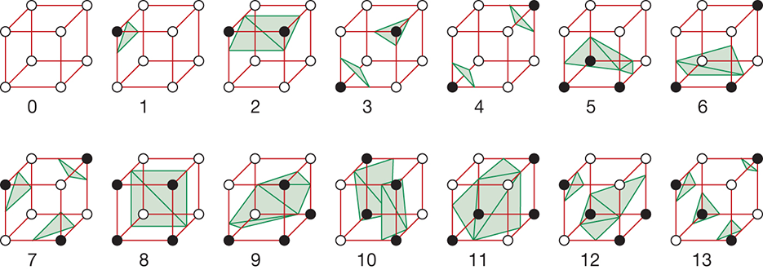
Volume Rendering: Marching Cubes
Once volume is polygonised, GPU can be used to render
Marching Cubes Video, Marching Cubes Example using WebGL

Slide 19
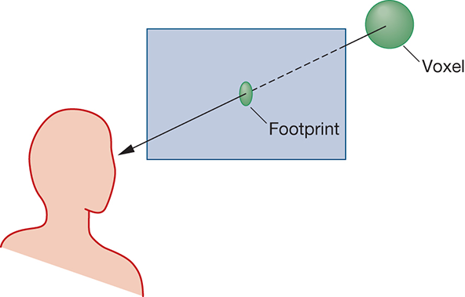
Volume Rendering: Splatting
Object-resolution volume rendering technique
Each volume element (voxel) is splatted on screen as a snowball
Voxels splatted in FTB or BTF order wrt to the viewer
Splats are rendered and composited as disks on the screen
Circular, ellipsoidal or Gaussian splats
Aliasing

Slide 20
Volume Rendering: V-Buffer
Image based volume rendering technique
Ray casting through volume
Trilinear interpolation to determine RGBA at non-lattice point
Accumulate color and opacity
3 levels of sampling:
Voxel lattice: x_{i,j,k}
Sampling along ray: y_{i}
Image plane: z_{i,j}
2 pipelines (color/opacity): c = c₁ + c₂(1 – α₁); α = α₁ + α₂(1 – α₁)

Slide 21
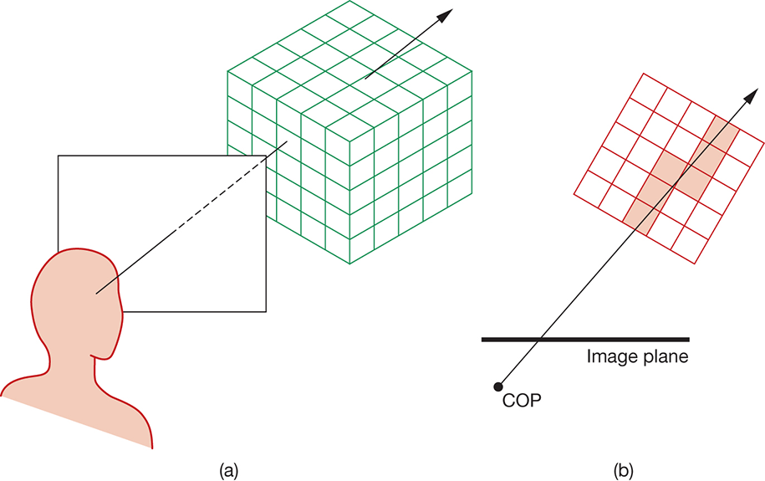
Volume Rendering: V-Buffer
Ray casting through volume
Parametric eqn of ray: p + t*d
p: pixel location
d: ray direction
t: parameter along ray
Step through ray by incrementing t

Slide 22
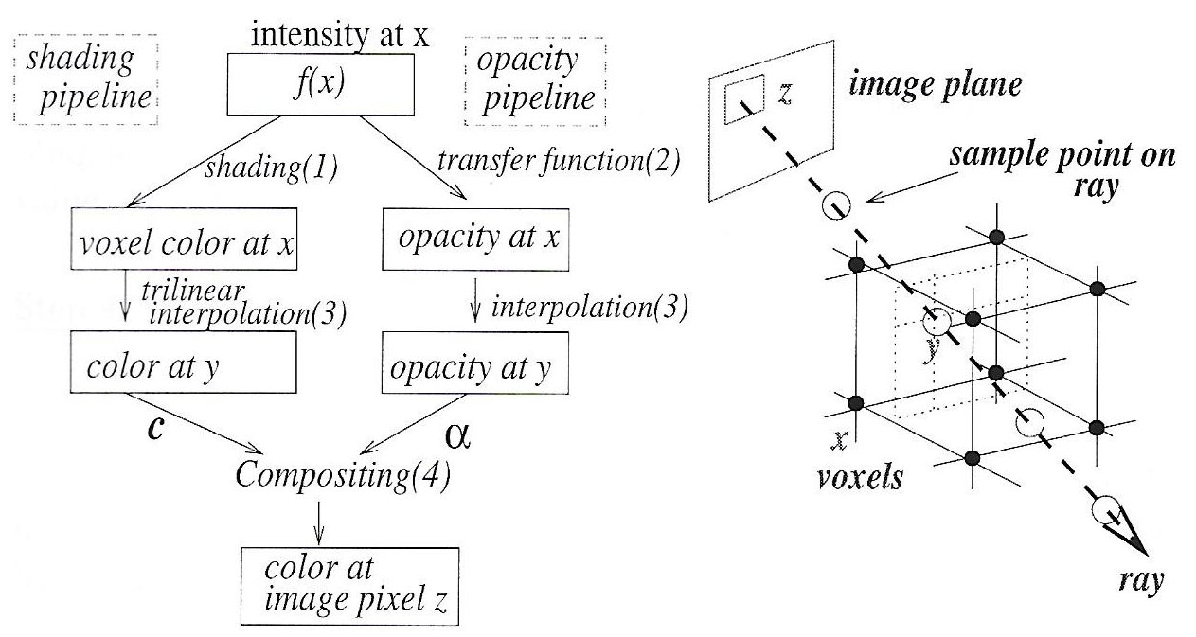
Volume Rendering
Algorithm

Slide 23
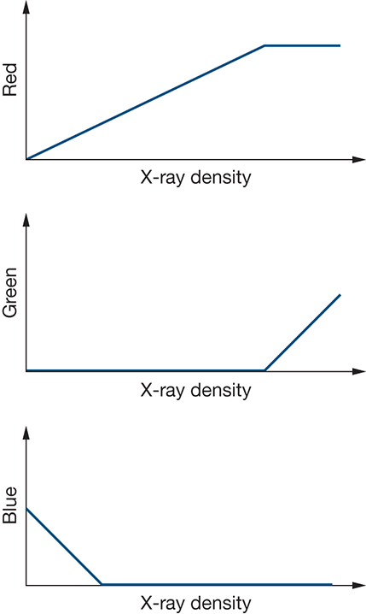
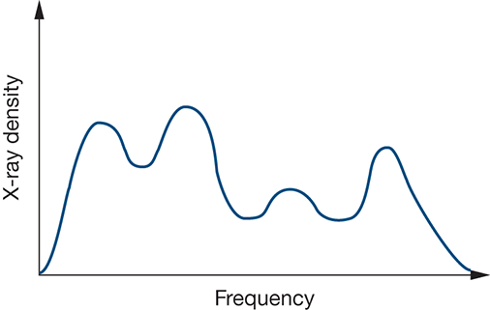
Volume Rendering: Transfer Function
X-Ray density data for each voxel
Assign different color to each peak in histogram
Opacity values based on emphasis

Slide 24
V-Buffer: Acceleration Techniques
Early ray termination
Stop when opacity reaches 1
Or when ray exits volume
Empty space skipping
Octree or BSP trees
Temporal use of voxels

Slide 25

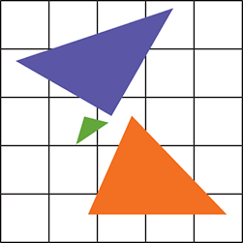
Aliasing: Rasterization
Spatial aliasing in CG
Jagged lines while rasterization
Going from continuous representation to a sampled approximation, which has limited resolution
Pixels on screen have fixed number, size, shape and location
Splatting during volume rendering

Slide 26
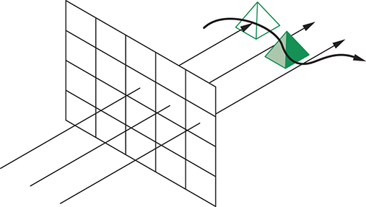
Aliasing: Temporal
Temporal aliasing in CG

Slide 27
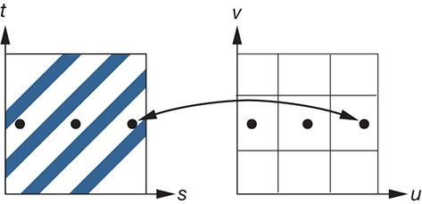
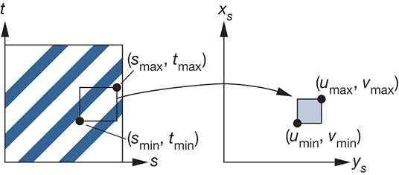
Aliasing: Mappings
Due to high-frequency patterns
Mip Mapping (as in A4)

Slide 28
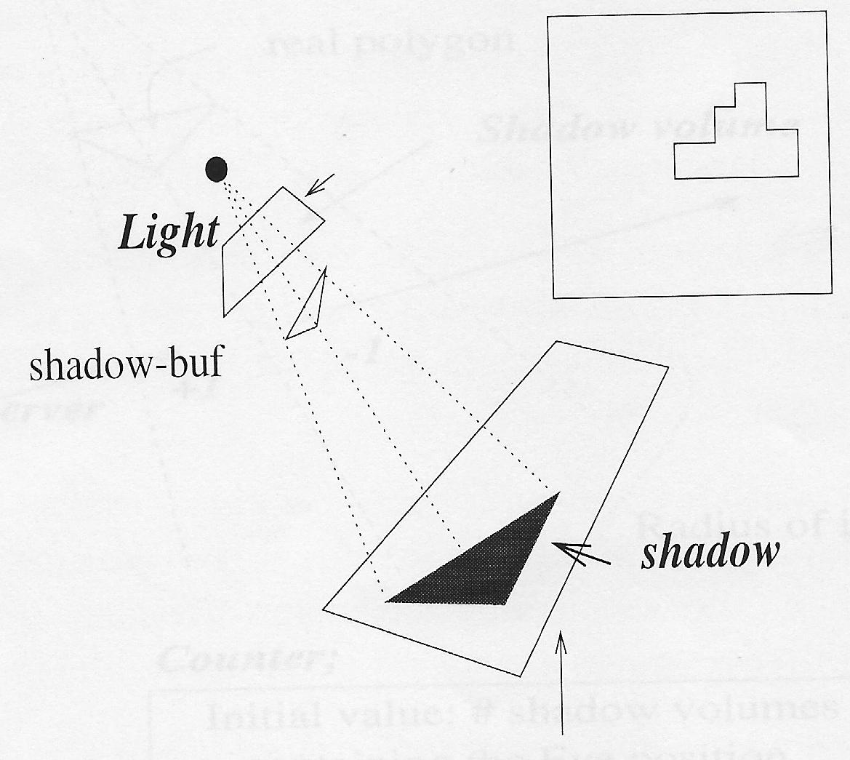
Aliasing: Shadows
Blocky shadow borders

Slide 29
Aliasing: Splatting
Shape of splat

Slide 30
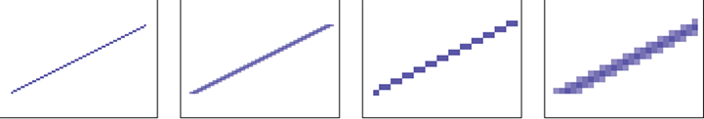
Anti-Aliasing
Area averaging
Super-sampling, then averaging or blending
Stochastic (or distributed) super-sampling
In h/w, use super-sampled offline buffer, then average to frame buffer

Slide 31
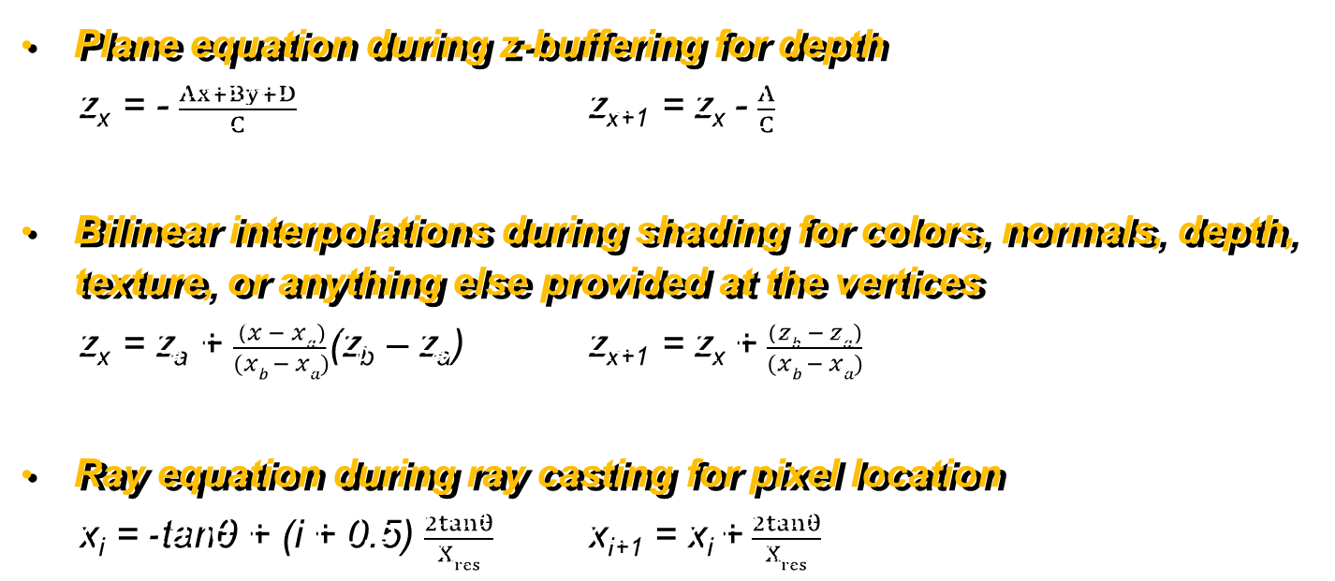
Incremental Calculations
Plane equation during z-buffering for depth z_{x} = - $\frac{Ax+By+D}{C}$ z_{x+1} = z_{x} - $\frac{A}{C}$
Bilinear interpolations during shading for colors, normals, depth, texture, or anything else provided at the vertices z_{x} = z_{a} + $\frac{(x − xa)}{(xb − xa)}$(z_{b} – z_{a}) z_{x+1} = z_{x} + $\frac{(zb − za)}{(xb − xa)}$
Ray equation during ray casting for pixel location x_{i} = -tanθ + (i + 0.5) $\frac{2tanθ}{Xres}$ x_{i+1} = x_{i} +$\frac{2tanθ}{Xres}$

